Slide 1

DATA SCIENCE &
ARTIFICIAL INTELLIGENCE
Seattle Airbnb Open Dataset

Slide 2
PROBLEM STATEMENT
Helping owners to predict appropriate prices to determine if their house is undervalued or overvalued, and also performing sentiment classification to find out how to improve their houses from reviews.

Slide 3
EXPLORATORY
DATA ANALYSIS
Initial investigation on data to visualise patterns

Slide 4
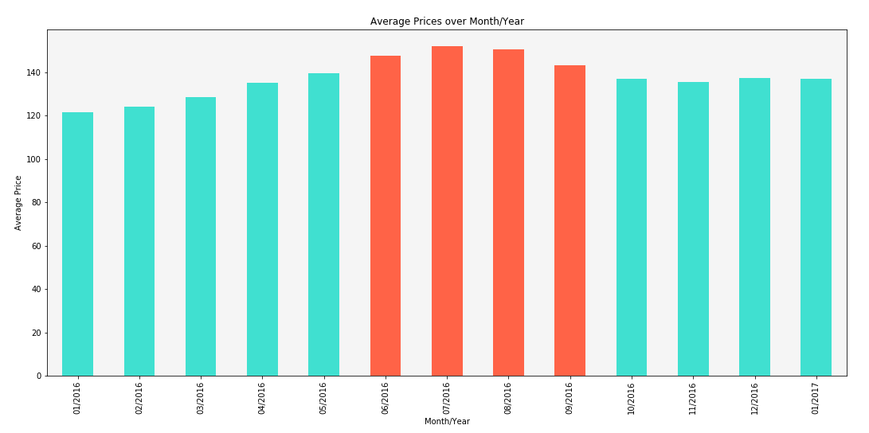
PRICING TREND OVER A YEAR
Interesting findings
Observation: Prices peaked during the months of June to September
Possible explanation: Summer break period where more people go on holidays

Slide 5
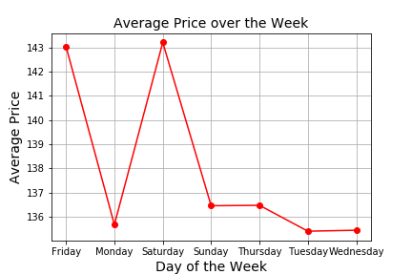
PRICING TREND OVER A WEEK
Interesting findings
Observation: Fridays and Saturdays have significantly higher prices
Possible explanation: Weekend time frame, where most people take a break from work, thus more people might be renting Airbnbs.

Slide 6
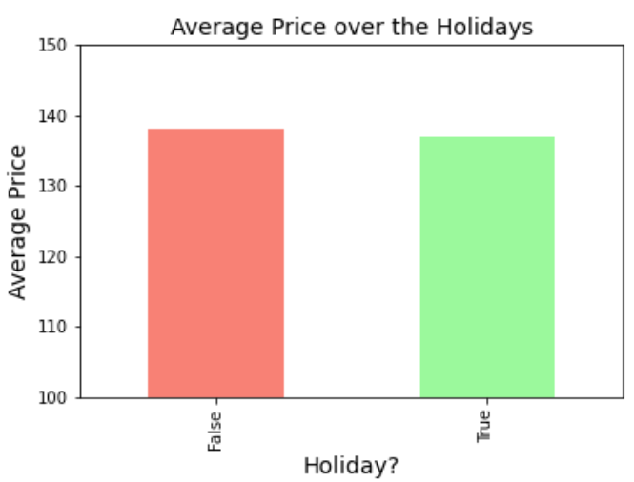
PRICING TREND DURING HOLIDAYS
Interesting findings
Observation: Rather equal in pricing for both holidays and non-holidays which was surprising to us

Slide 7
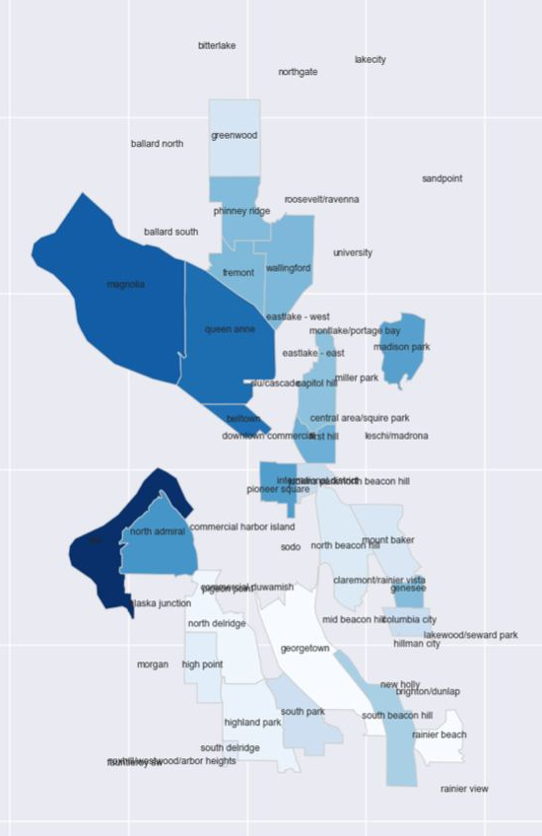
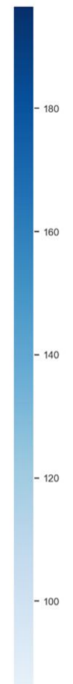
EXPLORATORY DATA ANALYSIS
Longitude
Interesting findings: Pricing with location
Observation: Prices are highest around the central
area of Seattle
Possible explanation: Most of the attractions are located there hence, there is a higher demand for houses there
Latitude
Price

Slide 8
MACHINE LEARNING MODELS WE’VE USED
Linear Regression
Sentiment Analysis
Random Forest Regression
Pycaret
Keras
Predicting Price through uni and multi-variable regressions
Sieving through common complaints for improvement of homes
Comparing different machine learning models and determining the best one
Construction of neural network
Predicting Price through uni-variable regression

Slide 9
DATA PREPARATION
Cleaning and structuring the data

Slide 10
DATA CLEANING & STRUCTURING
Numerical Data
+
Key Numerical Features
CLEAN
Unstructured Data
New Numerical Data
CONVERT
+
Cleaned Data
MERGE
Categorical Data
Key Categorical Features
CLEAN
Vectors
NLP Data
CONVERT

Slide 11
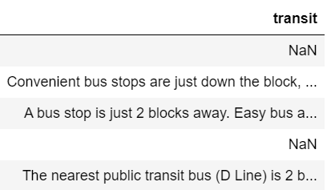
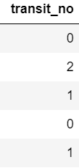
DATA CLEANING & STRUCTURING
01.
CONVERTING UNSTRUCTURED DATA INTO NUMERICAL FORM
Converting unstructured data types into numerical form for implementation to regression models (price, transit, host_verfications)
int64

Slide 12
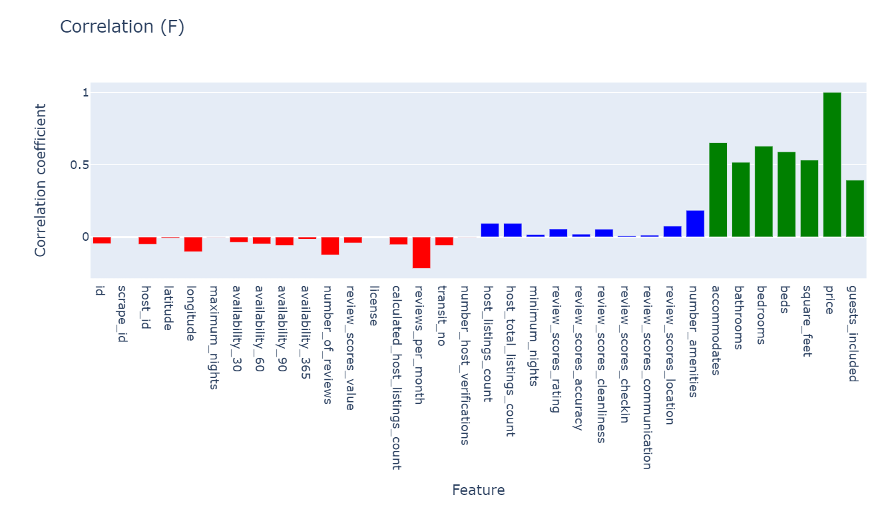
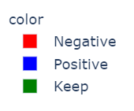
DATA CLEANING & STRUCTURING
02.
KEEPING NUMERICAL FEATURES THAT HAVE STRONG CORRELATION
Only correlations with absolute value greater than 0.35 are kept while others are dropped

Slide 13
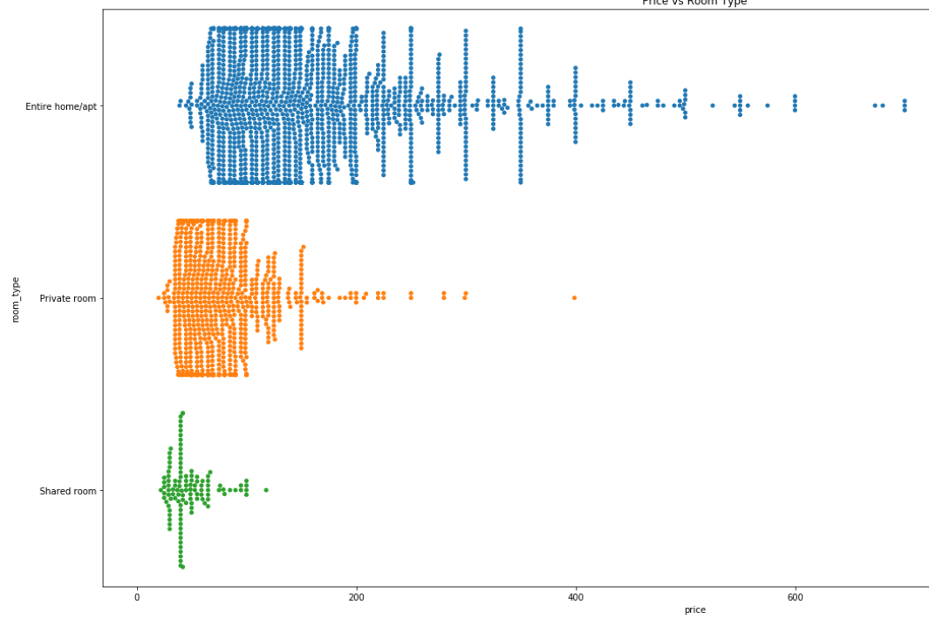
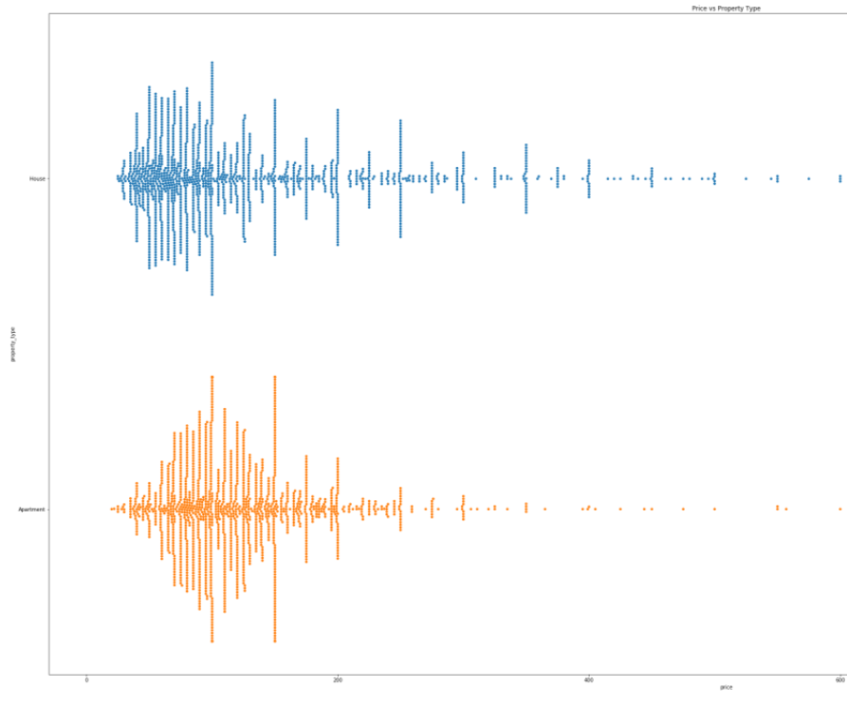
DATA CLEANING & STRUCTURING
03.
KEEPING CATEGORICAL FEATURES THAT DISTINGUISH PRICE
Exploring categorical data and deducing if the feature aids in distinguishing prices
Price vs Room Type
Price vs Property Type

Slide 14
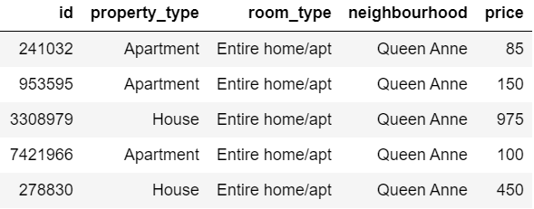
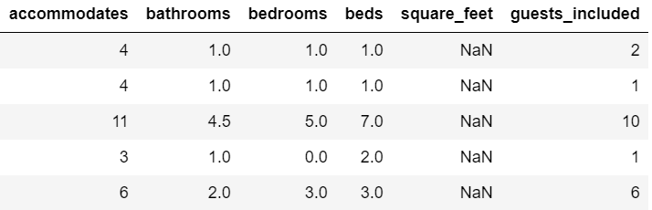
DATA CLEANING & STRUCTURING
04.
MERGING DESIRED FEATURES TOGETHER
We merged the desired categorical and numerical features into a single dataframe and save it as a csv for input into machine learning notebook.
Numerical Data + Categorical Data
cleaned_listing.csv

Slide 15
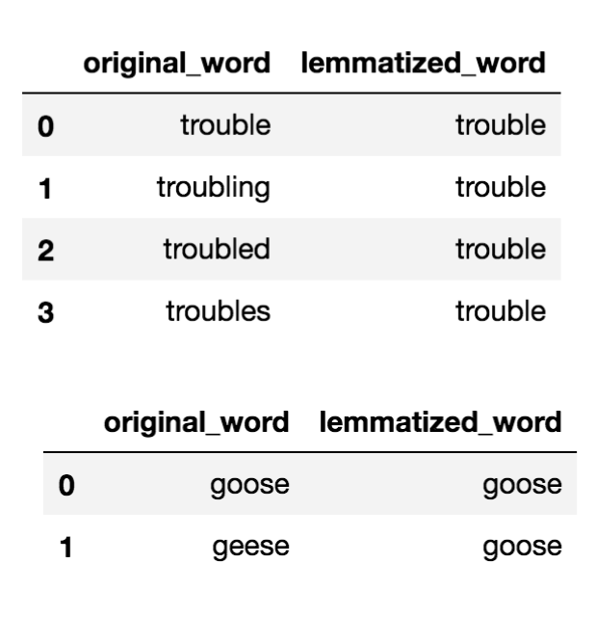
DATA CLEANING & STRUCTURING
05. CONVERTING WORDS TO TOKENS (for sentiment analysis)
STEP 01
STEP 02
STEP 03
Words
“The cat sat on the mat.”
Tokens
“The”, “cat”, “sat”, “on”, “the”, “mat”
Tokens
“The”, “cat”, “sat”, “on”, “the”, “mat”
Removing stopwords
Removing punctuations and converting the words to tokens.
Lemmatize Words

Slide 16
MACHINE LEARNING
Tools and techniques to analyse the data

Slide 17
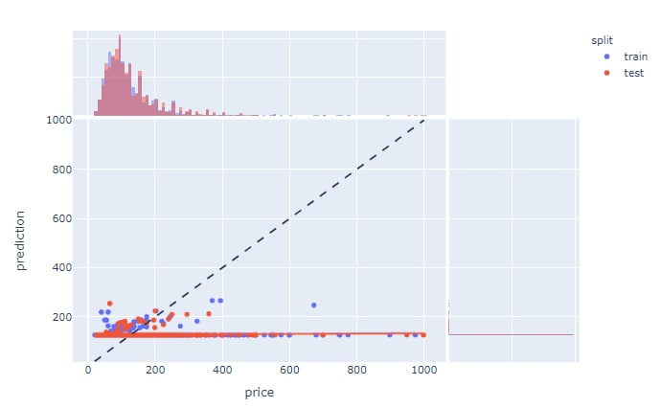
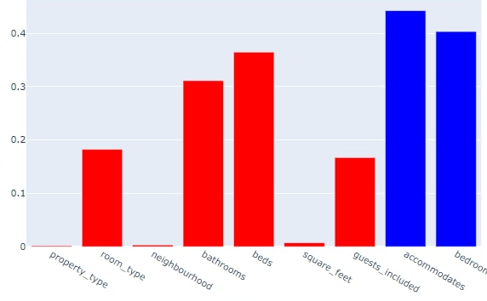

LINEAR REGRESSION on UNI-VARIABLES
Square Feet Linear Regression Actual vs Result
Correlation for each single variable
Predicted Price
Explained Variance
Actual Price
Features
Uni Variables are not an effective predictor of price

Slide 18
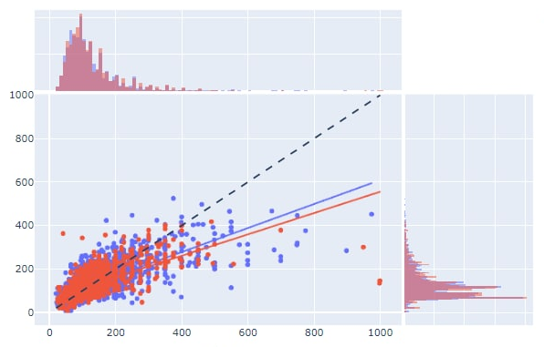
LINEAR REGRESSION on MULTI-VARIABLES
Multivariable Linear Regression Actual vs Result
Predicted Price
Actual Price
Since more points were on the best fit line, multi variable linear regression is an effective predictor of price.

Slide 19
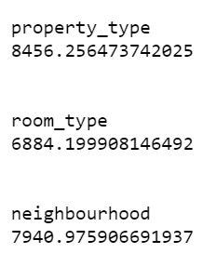
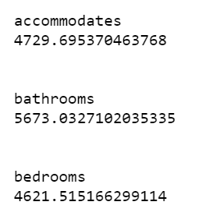
RANDOM FOREST REGRESSION on UNI-VARIABLES
Similar to decision trees, Random forest regression uses the ensemble method which creates multiple models and combines them to improve results
Input Variable
Mean Squared Error obtained from uni-variables
Tree 1
Tree 2
Average Result

Slide 20
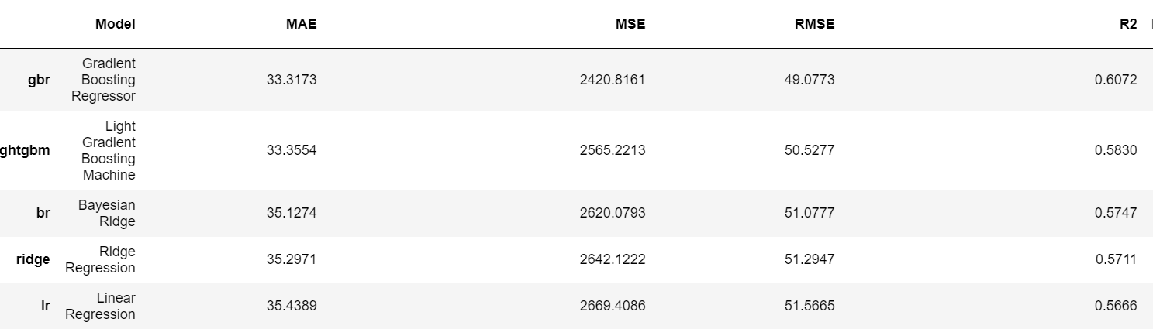
PYCARET
Pycaret is a Python low-code library that helps you perform model selection allowing us to spend less time coding and more time on results and data analysis.
After comparing ML models using PYCARET, gradient boosting regressor has the highest R^2 value, hence it is the best model for predicting price.

Slide 21
GRADIENT BOOSTING REGRESSOR (after tuning)
IN PREDICTING PRICES
61%
59%
TRAIN DATASET
TEST DATASET
As seen from the results, the model performed a little worse on the test dataset, which is as expected.

Slide 22
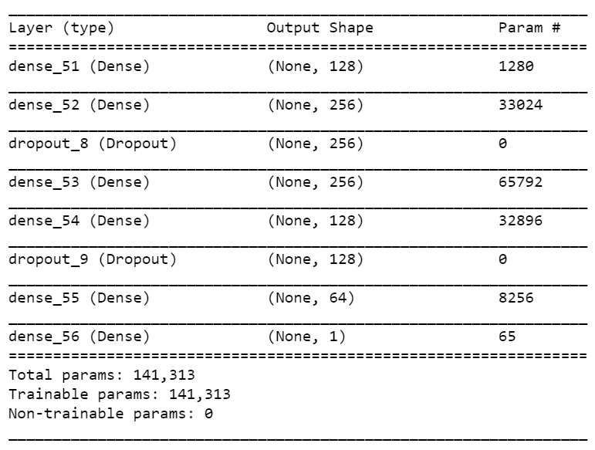

NEURAL NETWORK via KERAS
58%
TEST DATASET
Multiple layers
Mean Square Error : 3197

Slide 23
NATURAL LANGUAGE
PROCESSING
Where machines decipher and understand human language

Slide 24

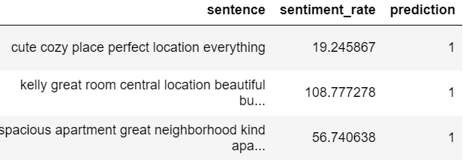
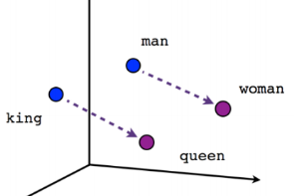

UNSUPERVISED SENTIMENT ANALYSIS
Negative words
Positive words
01
02
03
04
Converted words into vectors using Word2Vec
(similar words are close together)
Separating words into positive and negative groups using k-means clustering
Assign weights to words within a sentence using tf-idf vectorizer
Aggregated sentiment and tf-idf scores at sentence level and output prediction (0 for negative, 1 for positive)

Slide 25
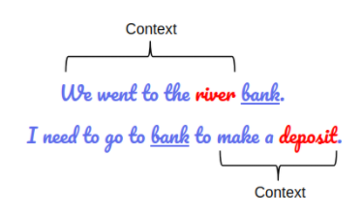
SUPERVISED SENTIMENT ANALYSIS
BERT
Bidirectional Encoder Representations from Transformers
Masking
Hides words from the model to better predict next words within a sentence
Attention
Enable the model to have longer memory and retains context from previous words

Slide 26
SUPERVISED SENTIMENT ANALYSIS
Input (2000 labelled sentences
Encoding (token, mask, segment)
BERT model (512 tokens)
Understand sentences
Keras layers
Dense (64)
Dropout
Dense (32)
Dropout
Classify sentences
-1: negative
0: neutral
1: positive
Output (3)

Slide 27

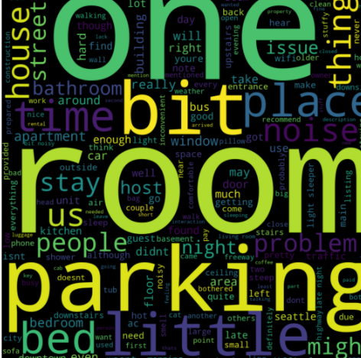
SUPERVISED SENTIMENT ANALYSIS
Accuracy on train set: 93%
Accuracy on test set: 89.5%
Positive word cloud generated
Negative word cloud generated

Slide 28
Conclusion
Outcomes
Reviewing objectives
Work Allocation

Slide 29
MACHINE LEARNING OUTCOME
PRICE (REGRESSION)
SENTIMENT (CLASSIFICATION)
Multivariate Gradient Boosting Regressor
BERT with neural network classifier
 | Train | Test
MSE | 2410 | 2540
R^2 | 0.608 | 0.598
 | Train | Test
Accuracy | 93.6% | 89.5%

Slide 30
REVIEWING OBJECTIVES
Predicted prices of houses using regression models
Highlighted improvements that can be made by owners using Sentiment Analysis
Gained interesting insights on the data from EDA
Experimented with various machine learning tools outside of syllabus
Gained knowledge on Natural Language Processing

Slide 31
FUTURE IMPLEMENTATIONS
Create an application for AirBnB hosts
Hosts receive advice on house pricings based on features
Hosts receive notifications when a negative review is given

Slide 32
WORK ALLOCATION
Leck Boon Kong
Machine Learning and Sentiment Analysis
Marcus Sing
Cleaning of the Dataset and Machine Learning
Samuel Ang
Exploration and Cleaning of the Dataset
Rei Ong
Exploration and Visualisation of the Dataset

Slide 33
Thank You!
Any Questions?

